Slide 1
Section 1
Scale-free property
Introduction

Slide 2
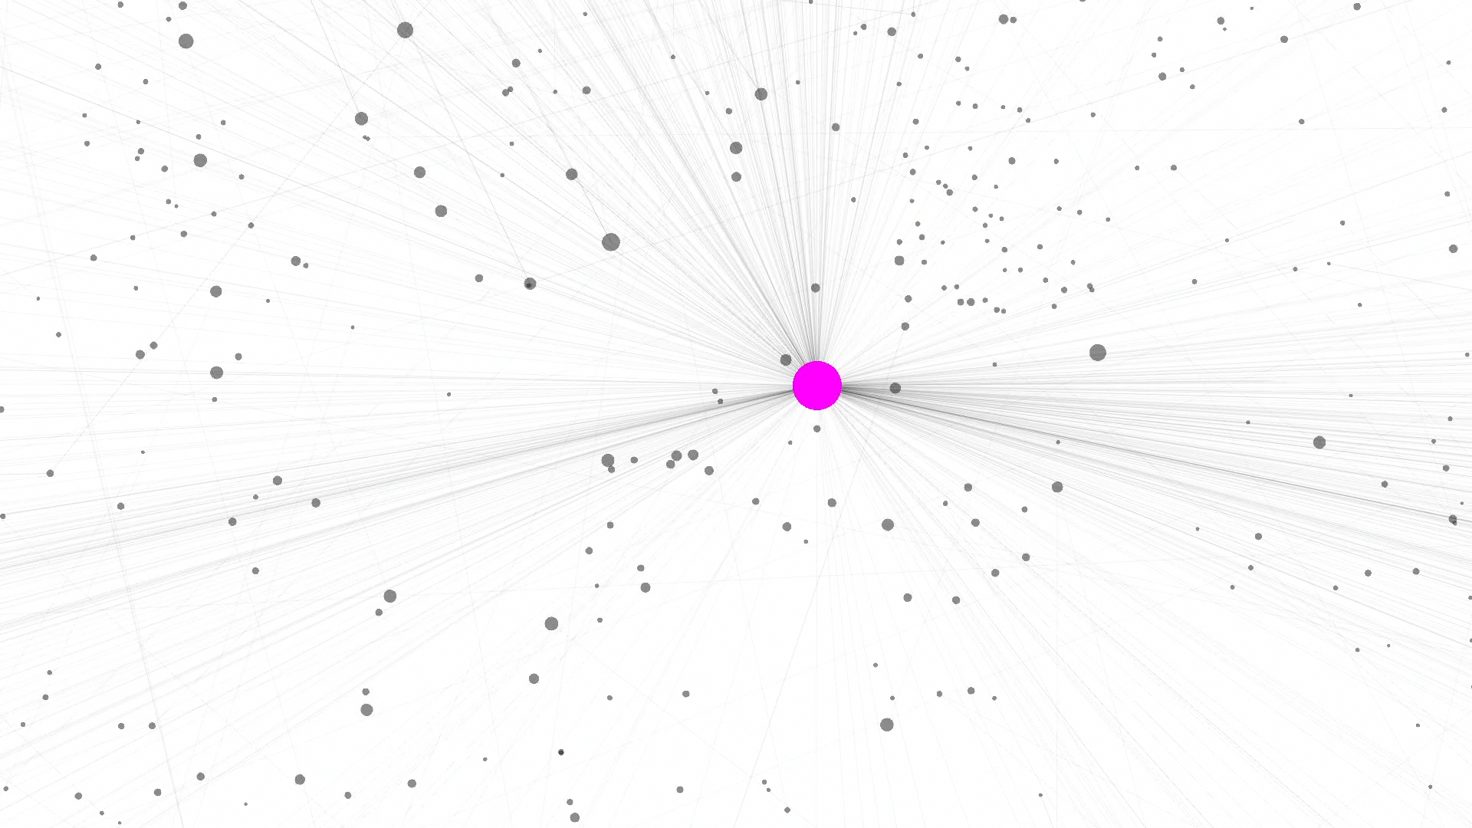
WORLD WIDE WEB
Nodes: WWW documents Links: URL links
Over 3 billion documents
ROBOT: collects all URL’s found in a document and follows them recursively
R. Albert, H. Jeong, A-L Barabasi, Nature, 401 130 (1999).

Slide 3
Section 2
Power laws and scale-free networks

Slide 4
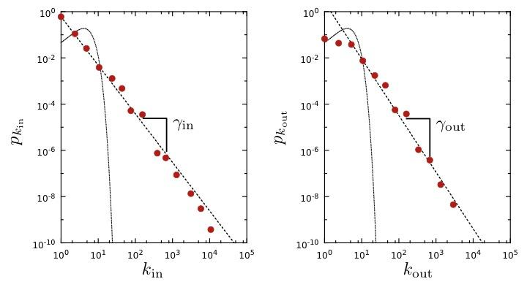
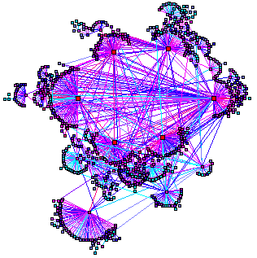
WORLD WIDE WEB
Nodes: WWW documents Links: URL links
Over 3 billion documents
ROBOT: collects all URL’s found in a document and follows them recursively
Expected
R. Albert, H. Jeong, A-L Barabasi, Nature, 401 130 (1999).
Network Science: Scale-Free Property

Slide 5
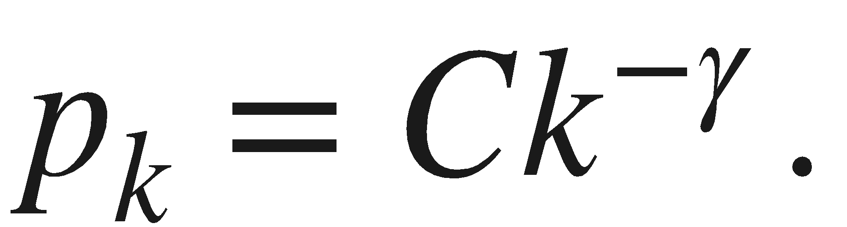
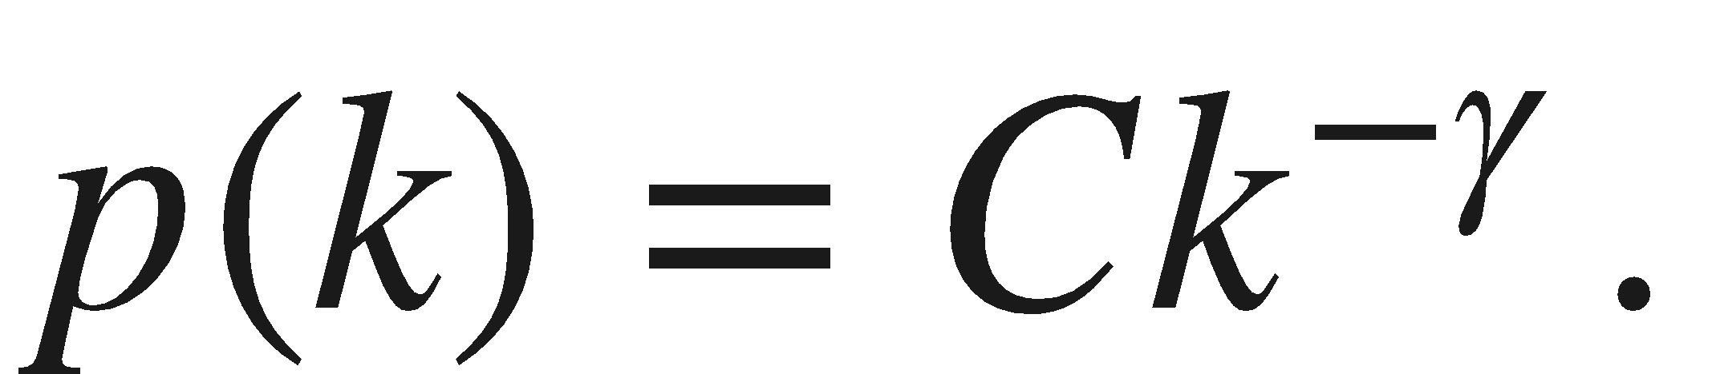
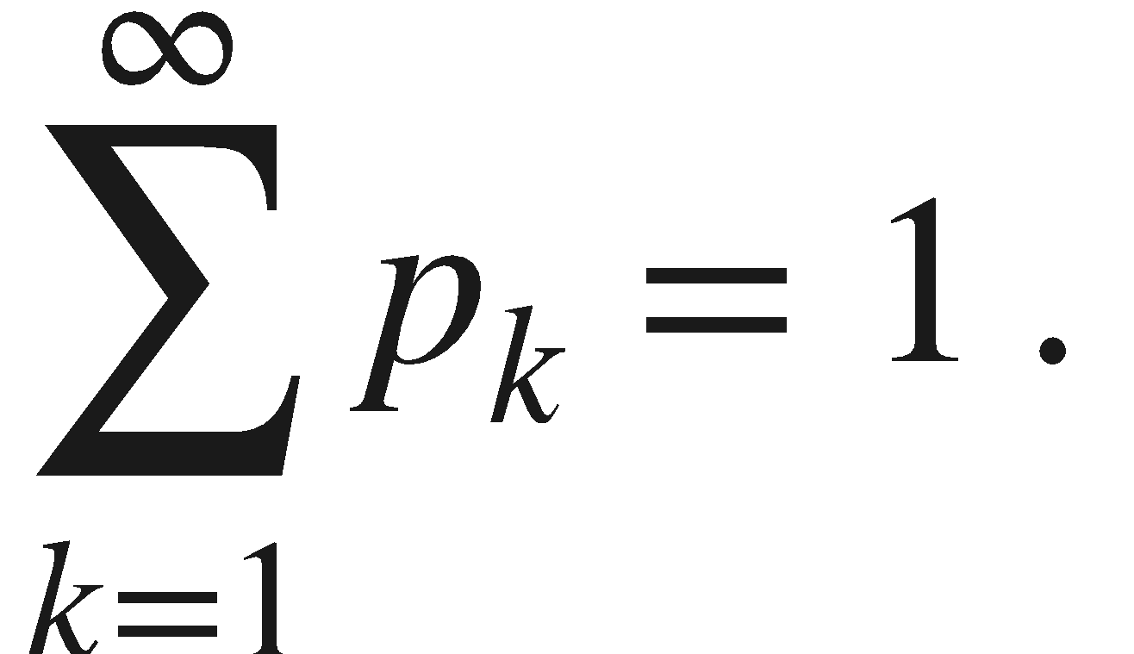
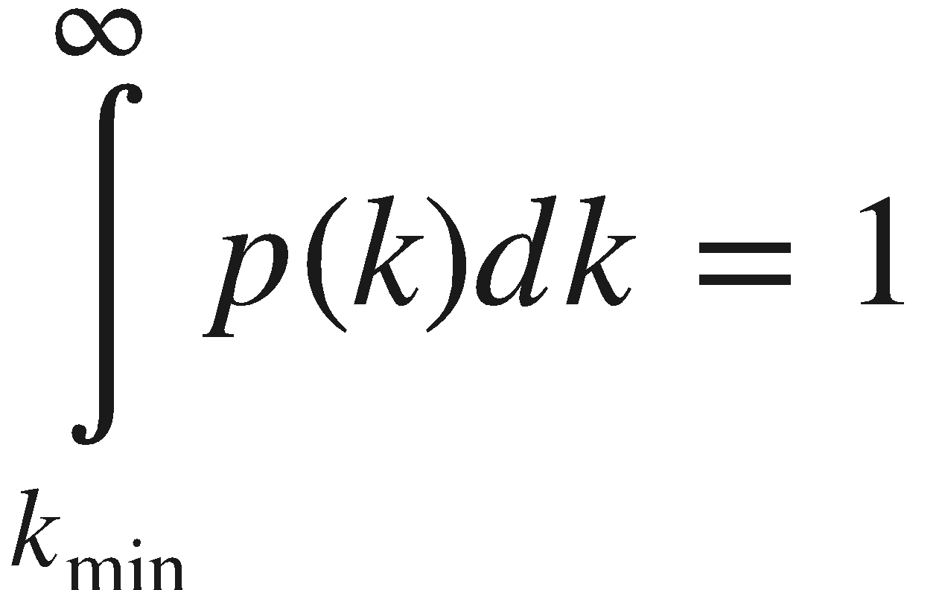
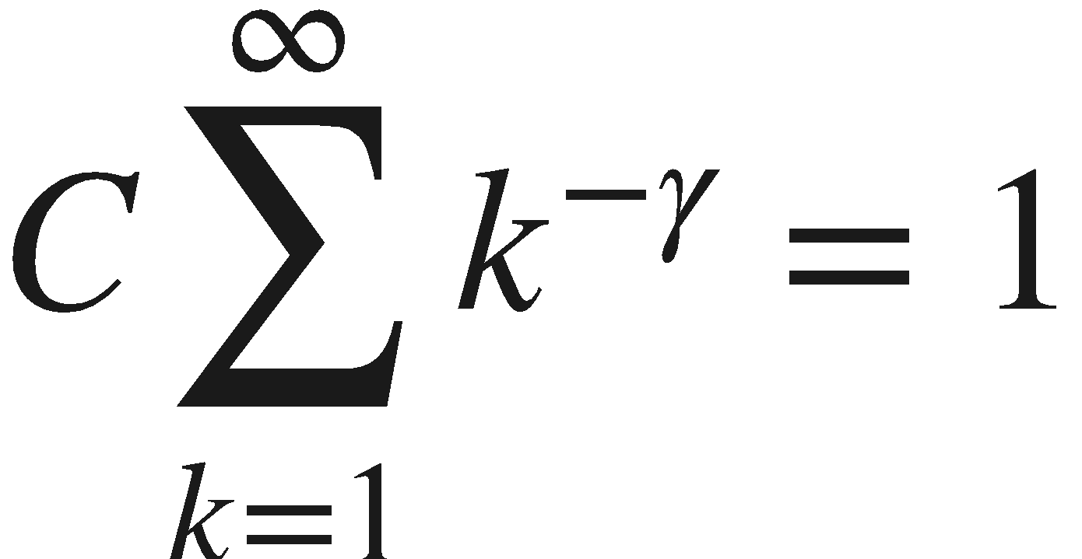
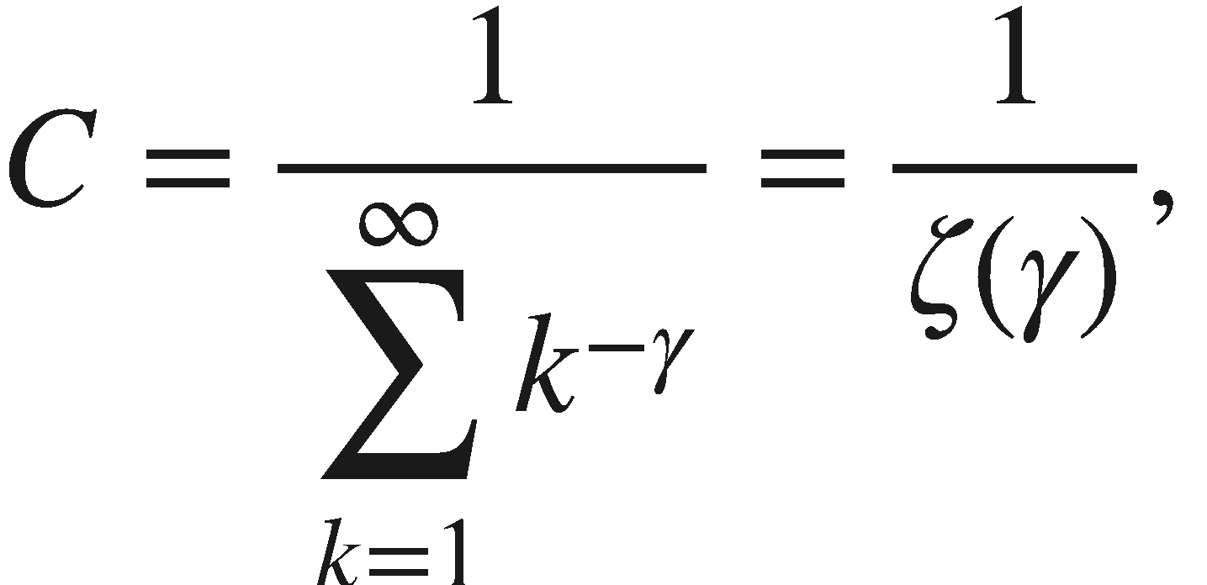
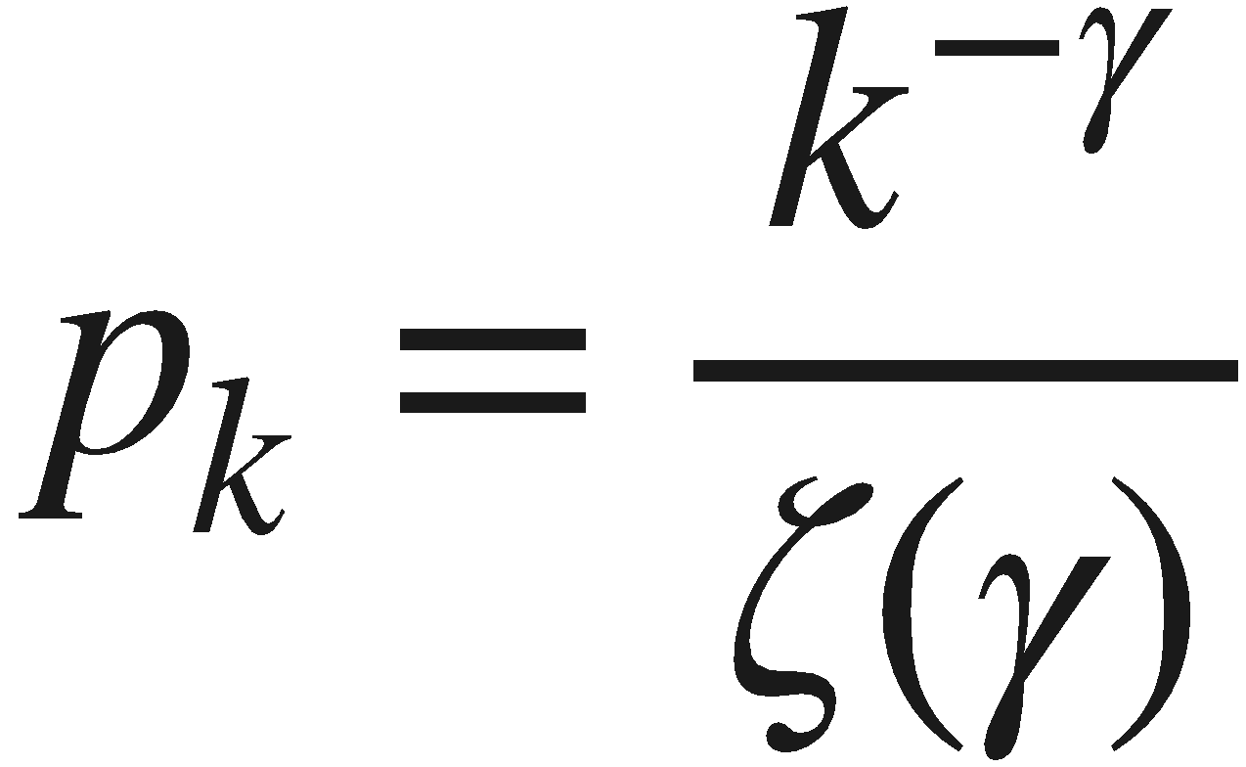
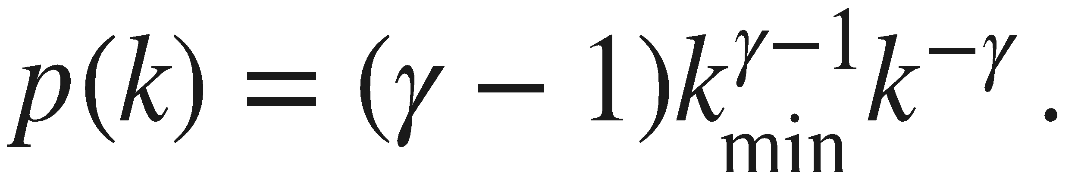
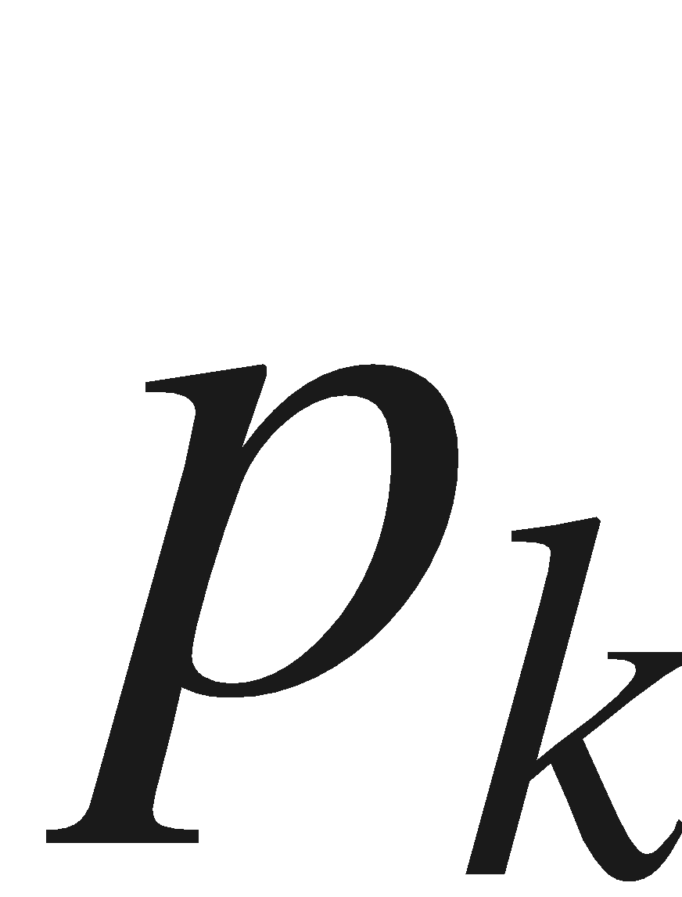
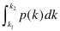
Discrete vs. Continuum formalism
Discrete Formalism
As node degrees are always positive integers, the discrete formalism captures the probability that a node has exactly k links:
Continuum Formalism
In analytical calculations it is often convenient to assume that the degrees can take up any positive real value:
INTERPRETATION:
Network Science: Scale-Free Property
Notes:
There appears to be little difference between them at the first look. Yet. There is some quite relevant different: the at high degrees the power law curve is always higher than the exponential.

Slide 6
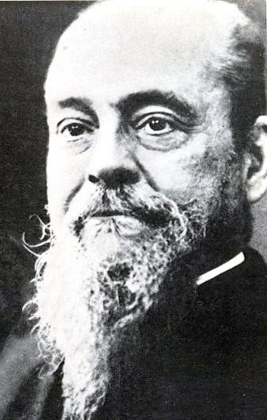
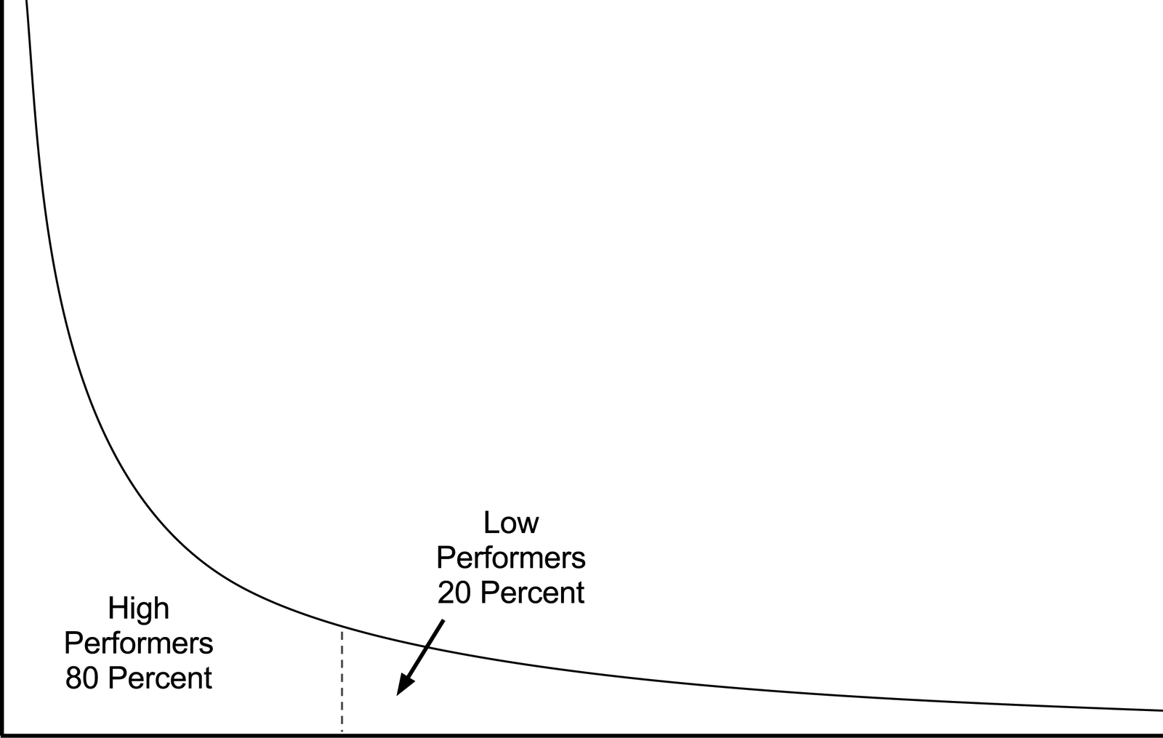
80/20 RULE
Vilfredo Federico Damaso Pareto (1848 – 1923), Italian economist, political scientist and philosopher, who had important contributions to our understanding of income distribution and to the analysis of individuals choices. A number of fundamental principles are named after him, like Pareto efficiency, Pareto distribution (another name for a power-law distribution), the Pareto principle (or 80/20 law).
Notes:
Vilfredo Pareto, a 19th century economist, noticed that in Italy a few wealthy individuals earned most of the money, while the majority of the population earned rather small amounts. He connected this disparity to the observation that incomes follow a power law, representing the first known report of a power law distribution [3]. His finding entered the popular literature as the 80/20 rule: roughly 80 percent of money is earned by only 20 percent of the population. The 80/20 emerges in many areas, like management, stating that 80 percent of profits are produced by only 20 percent of the employees or that 80 percent of decisions are made during 20 percent of meeting time. They are present in networks as well: 80 percent of links on the Web point to only 15 percent of webpages; 80 percent of citations go to only 38 percent of scientists; 80 percent of links in Hollywood are connected to 30 percent of actors [4]. Typically all quantities obeying the 80/20 rule follow a power law distribution. During the 2009 economic crisis power laws have gained a new meaning: the Occupy Wall Street Movement highlighted the fact that in the US 1% of the population earns a disproportionate 15% of the total US income. This 1% effect, a signature of a profound income disparity, is again a natural consequence of the power law nature of the income distribution.

Slide 7
Section 3
Hubs

Slide 8
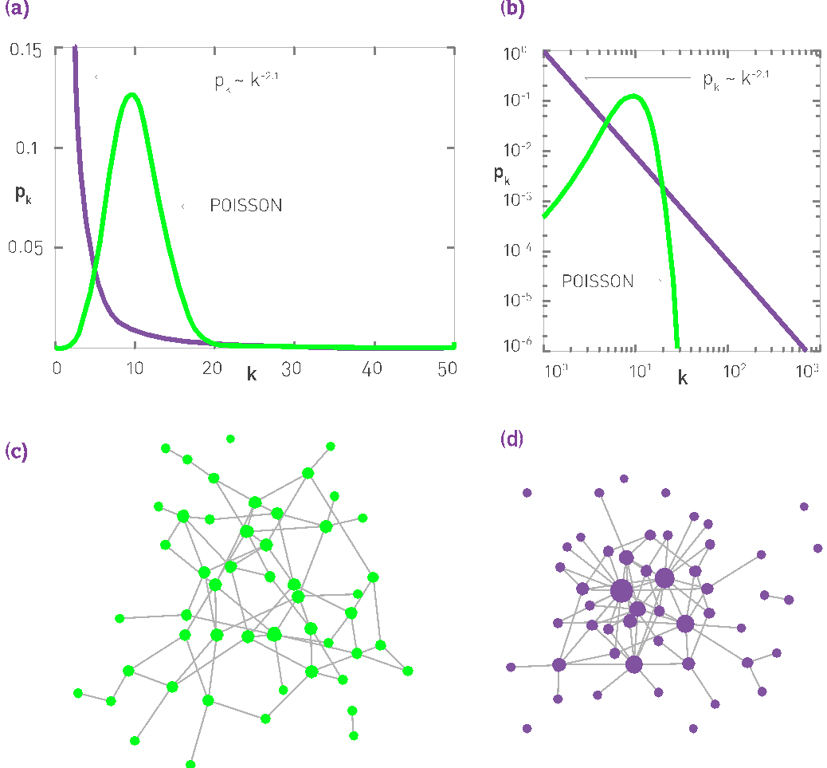
The difference between a power law and an exponential distribution
Notes:
There appears to be little difference between them at the first look. Yet. There is some quite relevant different: the at high degrees the power law curve is always higher than the exponential.

Slide 9
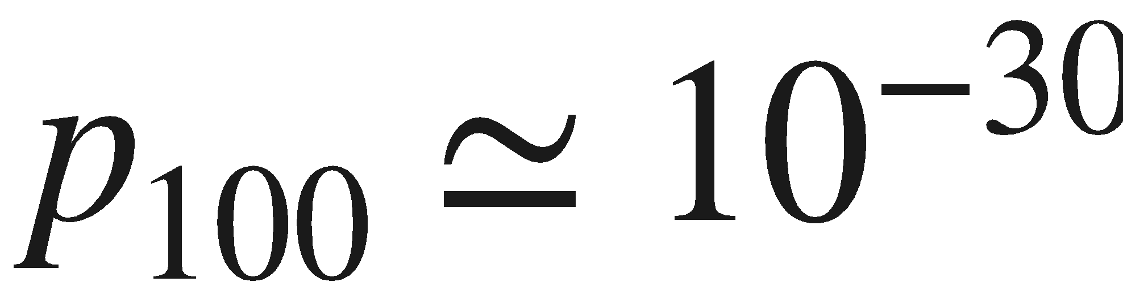
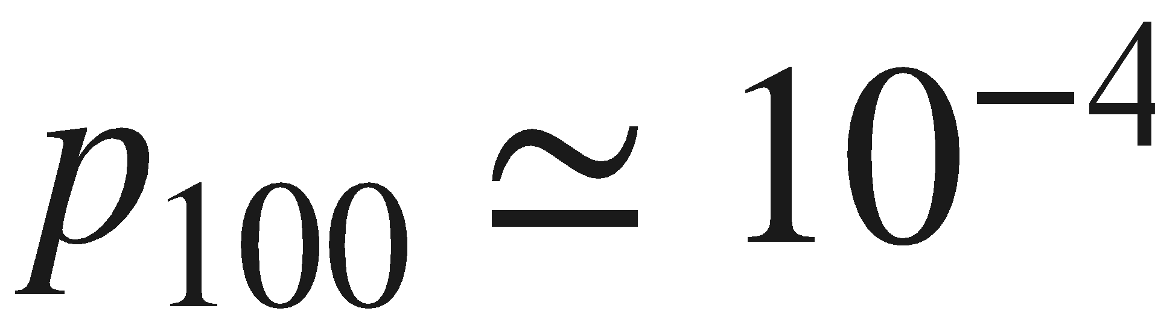
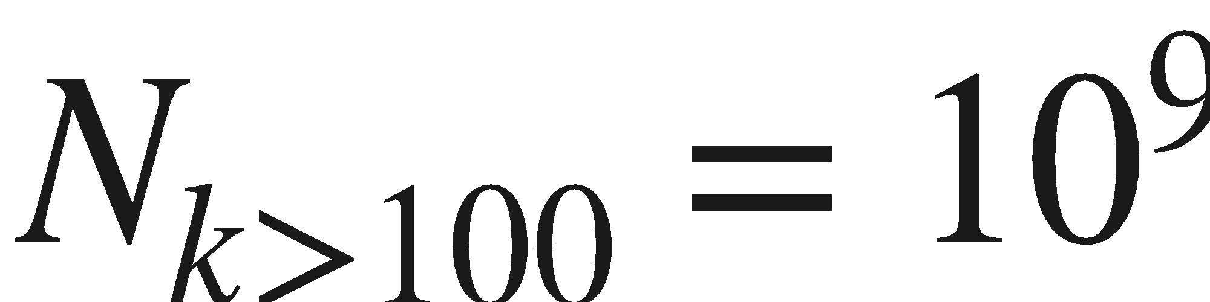
The difference between a power law and an exponential distribution
Let us use the WWW to illustrate the properties of the high-k regime.
The probability to have a node with k~100 is
About in a Poisson distribution
About if p_{k} follows a power law.
Consequently, if the WWW were to be a random network, according to the Poisson prediction we would expect 10⁻¹⁸ k>100 degree nodes, or none.
For a power law degree distribution, we expect about k>100 degree nodes
Notes:
There appears to be little difference between them at the first look. Yet. There is some quite relevant different: the at high degrees the power law curve is always higher than the exponential.

Slide 10
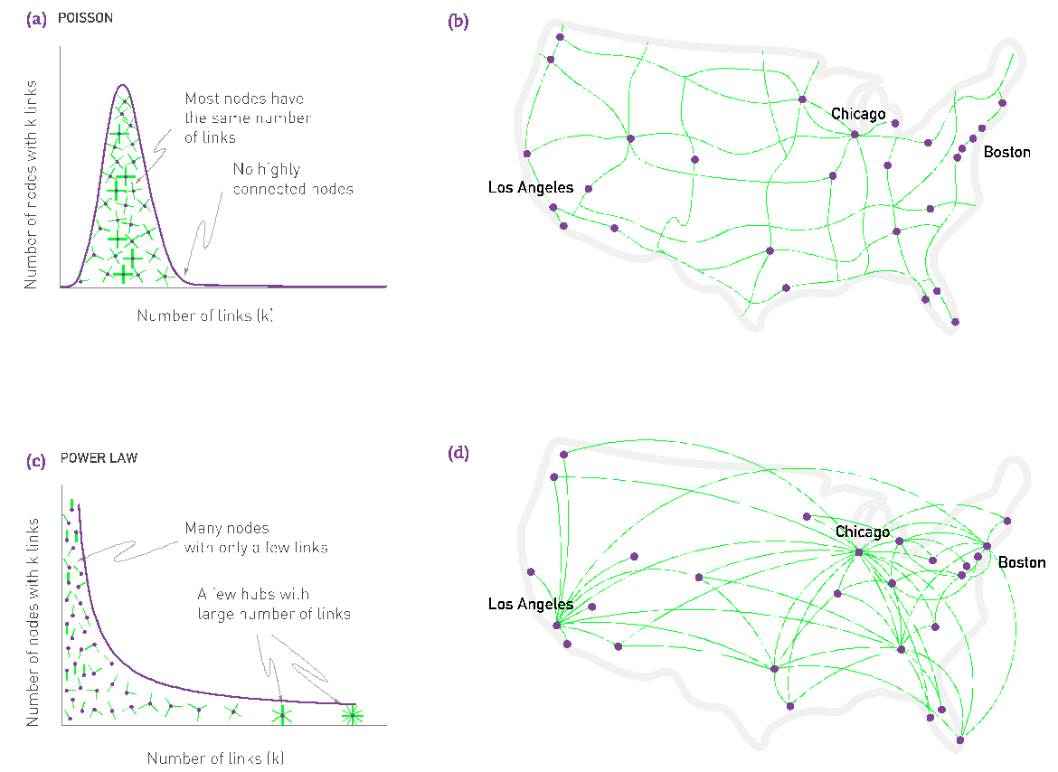
Network Science: Scale-Free Property
Notes:
There appears to be little difference between them at the first look. Yet. There is some quite relevant different: the at high degrees the power law curve is always higher than the exponential.

Slide 11
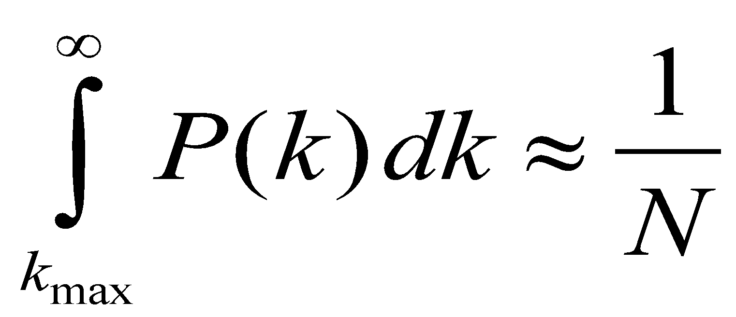
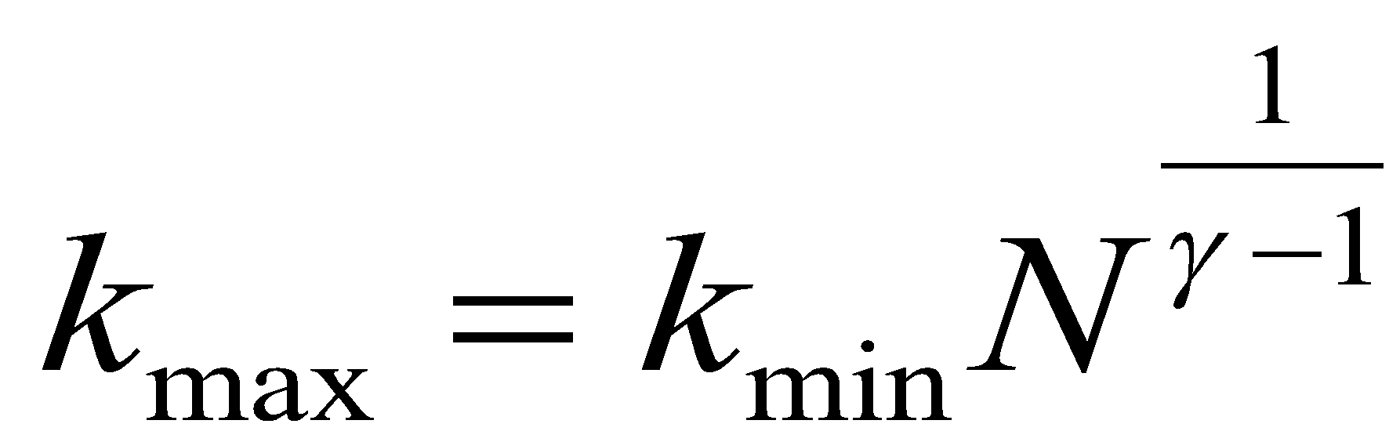
Finite scale-free networks
The size of the biggest hub
All real networks are finite 🡪 let us explore its consequences.
🡪 We have an expected maximum degree, k_{max}
Estimating k_{max}
Why: the probability to have a node larger than k_{max} should not exceed the prob. to have one node, i.e. 1/N fraction of all nodes

Slide 12
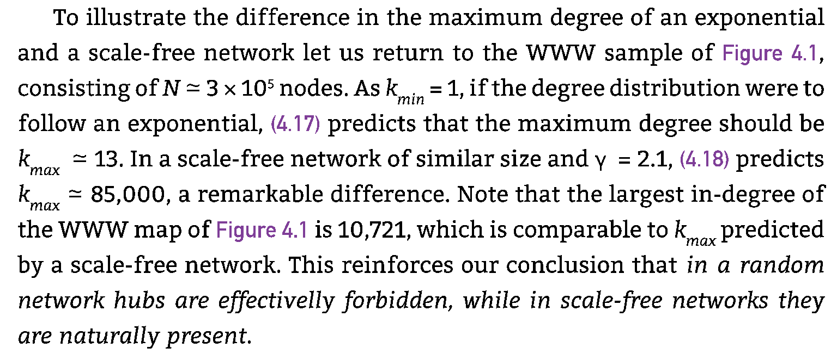
Finite scale-free networks
The size of the biggest hub

Slide 13
Finite scale-free networks
Expected maximum degree, k_{max}
k_{max}, increases with the size of the network
🡪the larger a system is, the larger its biggest hub
For γ>2 k_{max} increases slower than N
the largest hub will contain a decreasing fraction of links as N increases.
For γ=2 k_{max}~N.
🡪 The size of the biggest hub is O(N)
For γ<2 k_{max} increases faster than N: condensation phenomena
🡪 the largest hub will grab an increasing fraction of links. Anomaly!

Slide 14
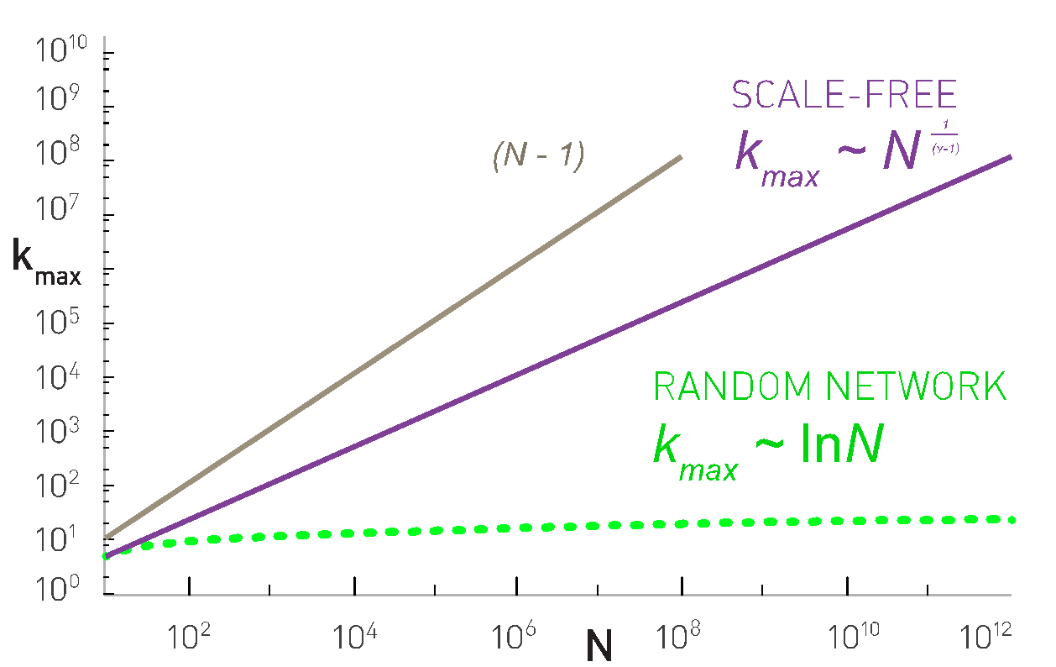
Finite scale-free networks
The size of the largest hub

Slide 15
Section 4
The meaning of scale-free

Slide 16
Scale-free networks: Definition
Definition:
Networks with a power law tail in their degree distribution are called
‘scale-free networks’
Where does the name come from?
Critical Phenomena and scale-invariance
(a detour)
Slides after Dante R. Chialvo
Network Science: Scale-Free Property
Slides after Dante R. Chialvo

Slide 17
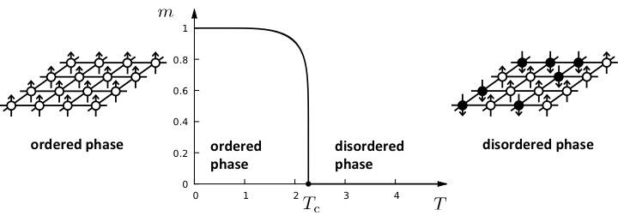
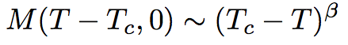
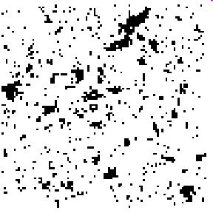
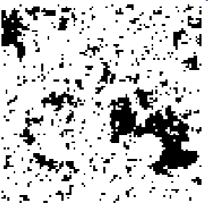
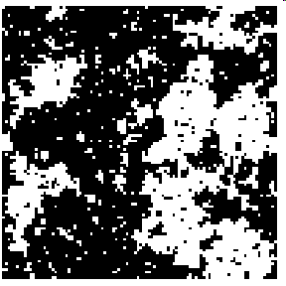
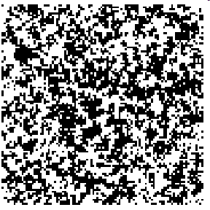
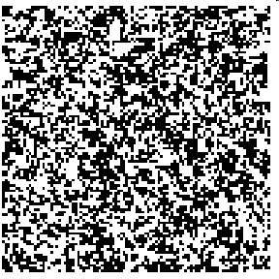
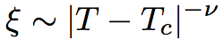
Phase transitions in complex systems I: Magnetism
T = 0.99 T_{c}
T = 0.999 T_{c}
T = T_{c}
T = 1.5 T_{c}
T = 2 T_{c}
ξ
ξ
Network Science: Scale-Free Property

Slide 18
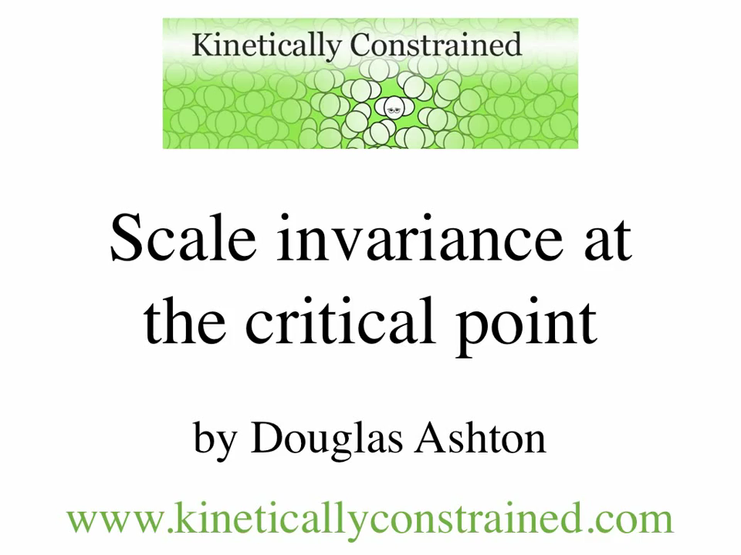
Scale-free behavior in space
At T = Tc:
correlation length diverges
Fluctuations emerge at all scales:
scale-free behavior
Network Science: Scale-Free Property

Slide 19
CRITICAL PHENOMENA
Correlation length diverges at the critical point: the whole system is correlated!
Scale invariance: there is no characteristic scale for the fluctuation (scale-free behavior).
Universality: exponents are independent of the system’s details.
Network Science: Scale-Free Property
Notes:
Now we see where the ‘scale-free’ name comes from. But what’s in the name?
We need to learn a bit more to understand that … soon
Before we get there, let us talk about universality.

Slide 20
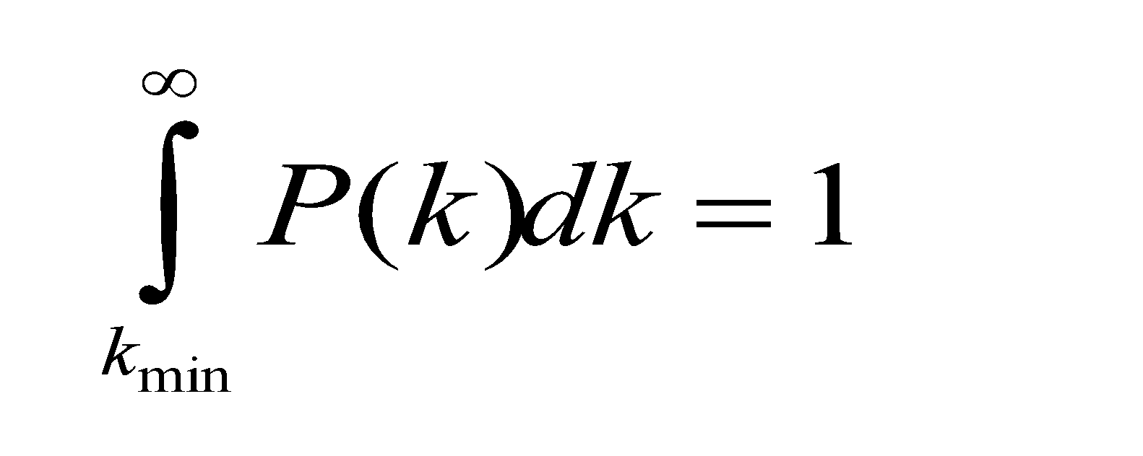
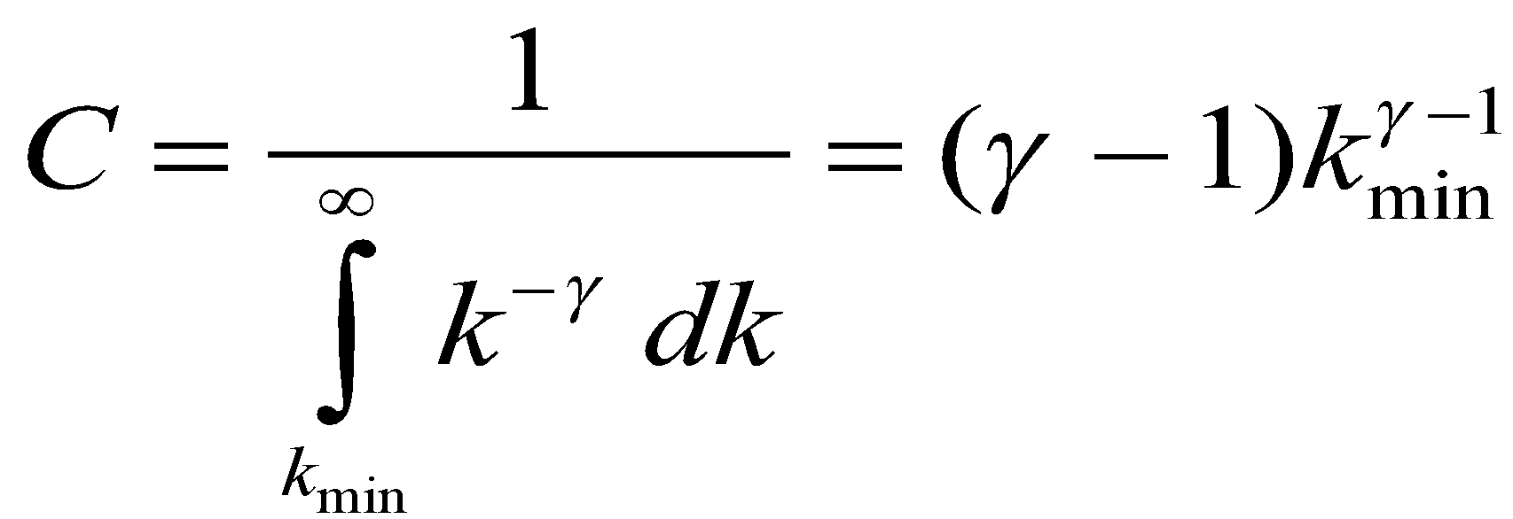
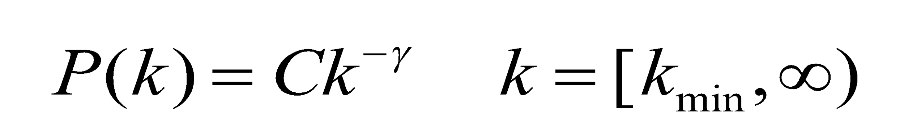
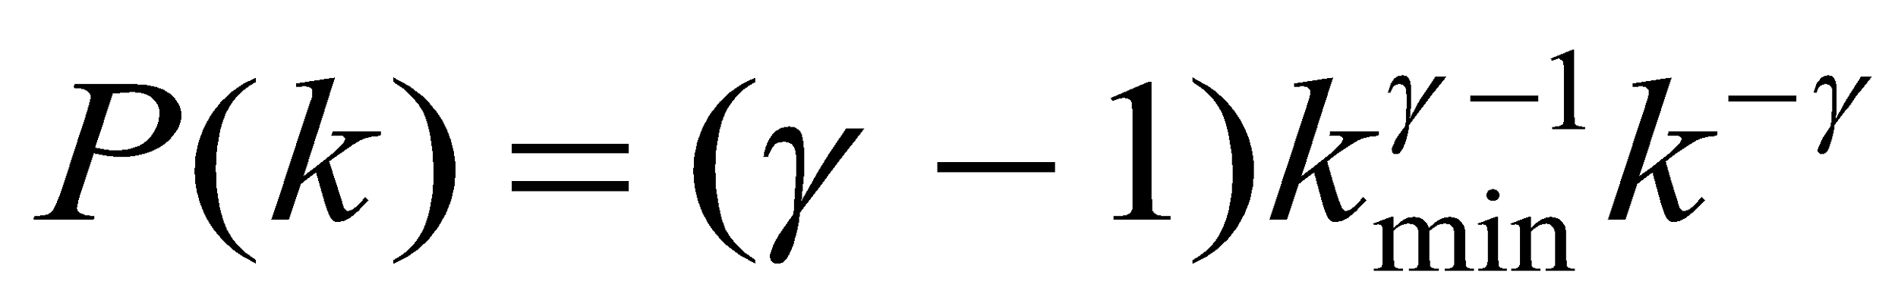
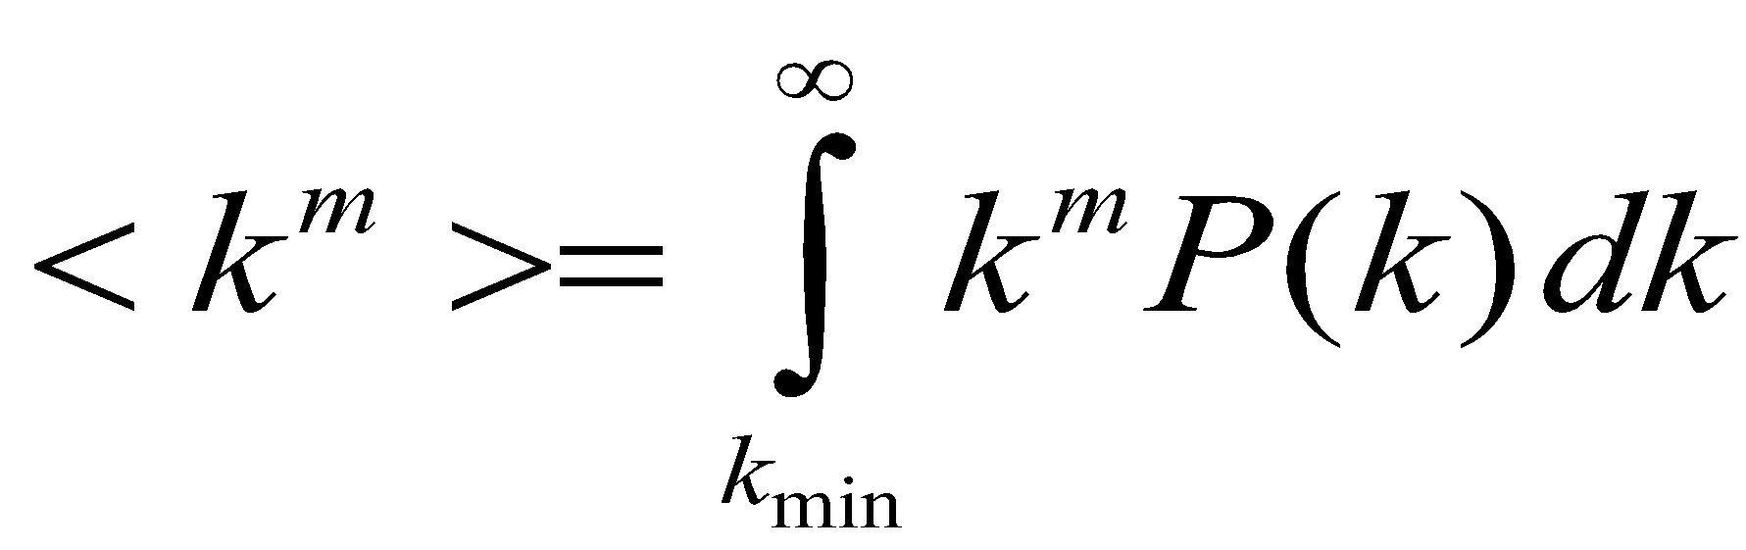
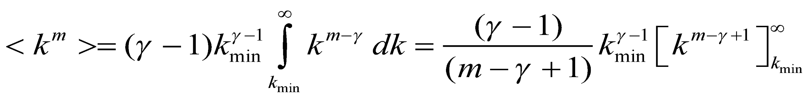
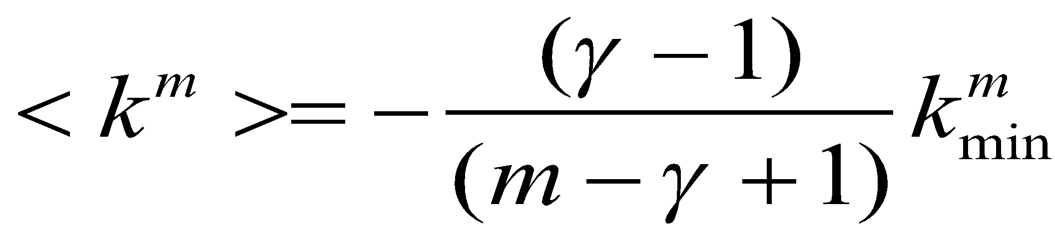
Divergences in scale-free distributions
If m-γ+1<0:
If m-γ+1>0, the integral diverges.
For a fixed γ this means that all moments with m>γ-1 diverge.
Network Science: Scale-Free Property

Slide 21
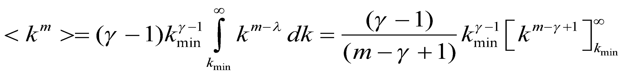
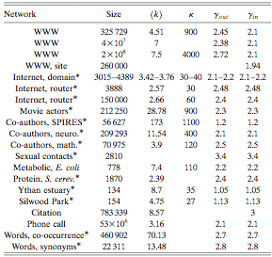
DIVERGENCE OF THE HIGHER MOMENTS
For a fixed λ this means all moments m>γ-1 diverge.
Many degree exponents are smaller than 3
🡪 <k²> diverges in the N🡪∞ limit!!!
Network Science: Scale-Free Property

Slide 22
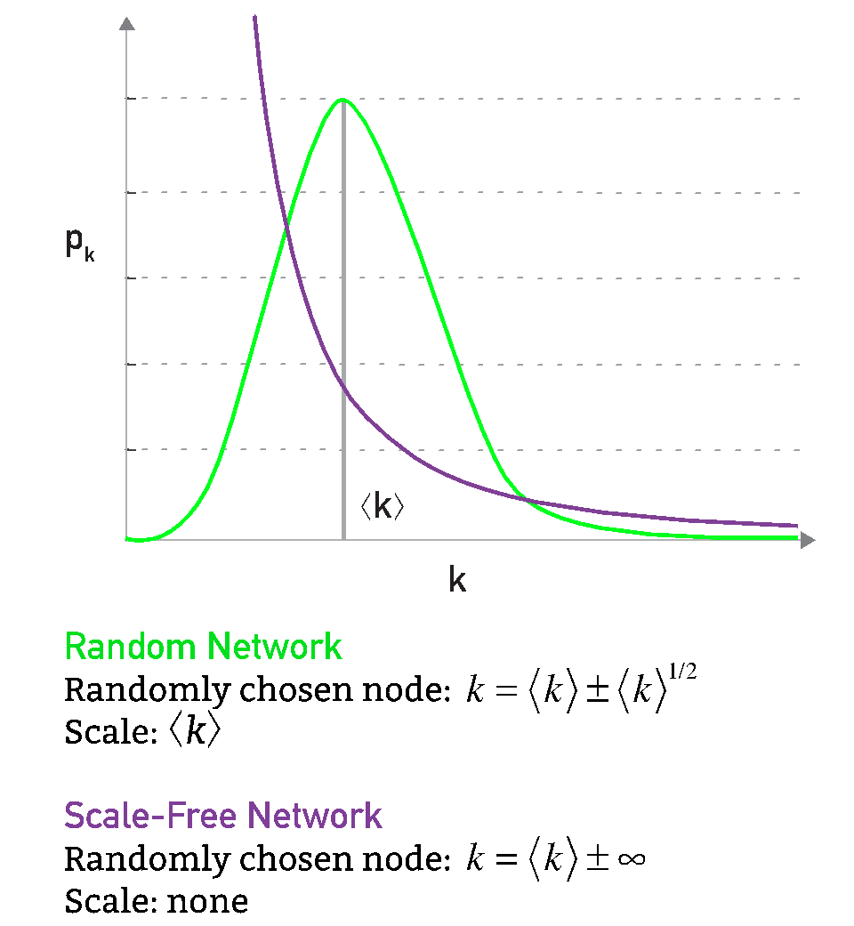
The meaning of scale-free

Slide 23
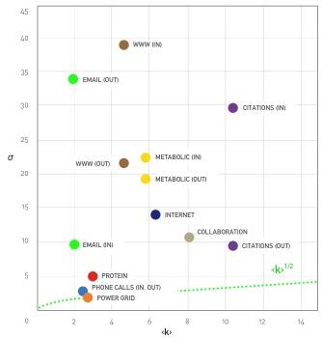
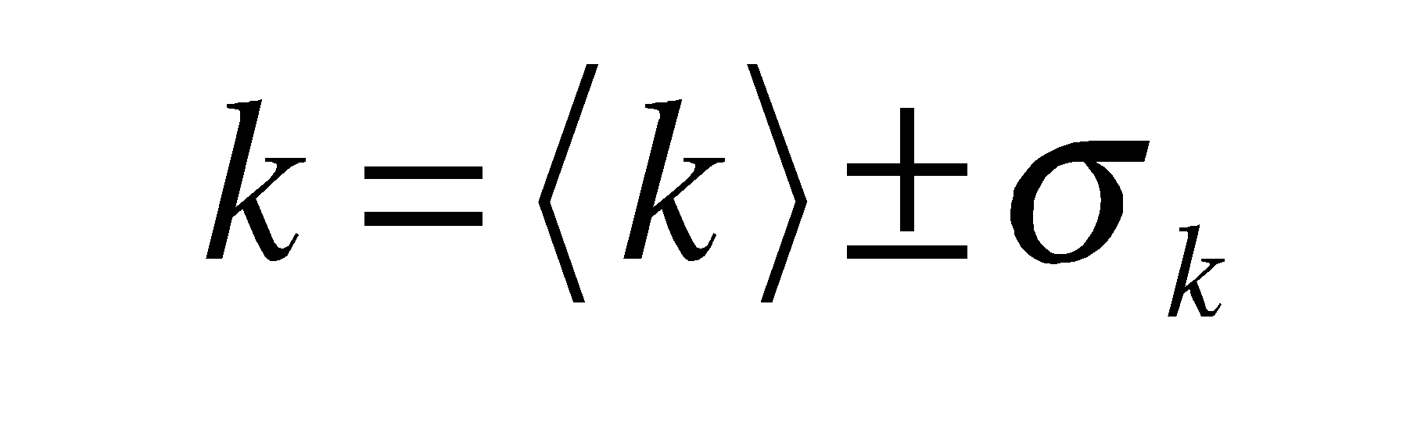
The meaning of scale-free

Slide 24
Section 5
universality

Slide 25
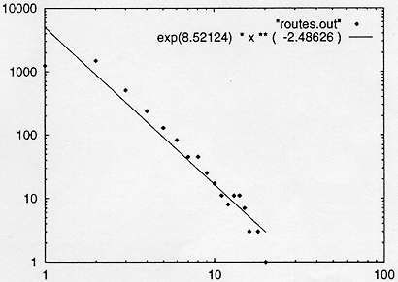
INTERNET BACKBONE
Nodes: computers, routers
Links: physical lines
(Faloutsos, Faloutsos and Faloutsos, 1999)
Network Science: Scale-Free Property

Slide 26
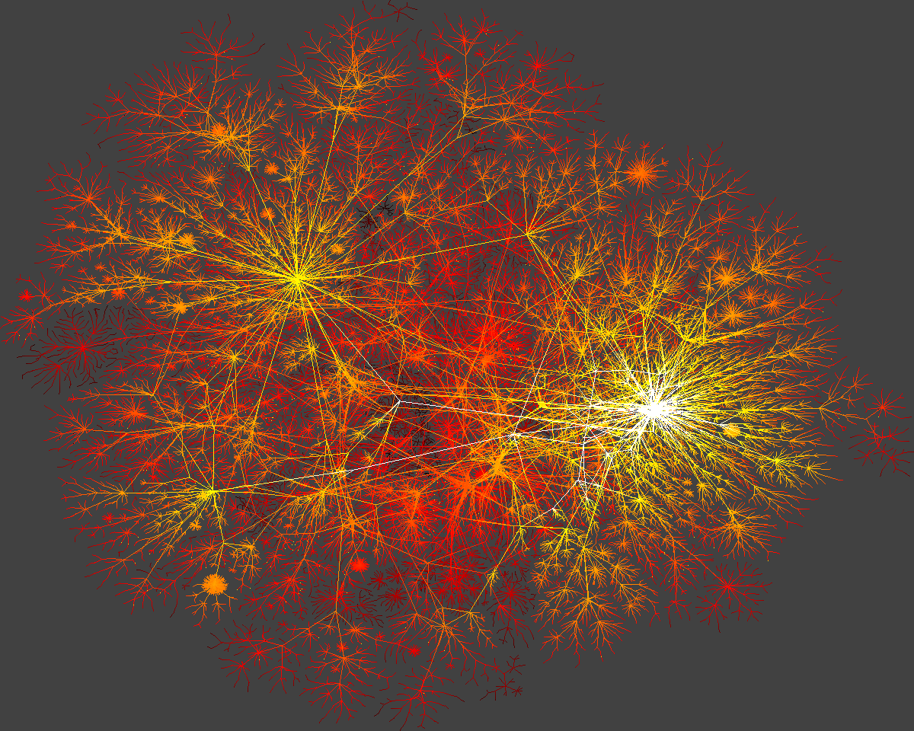
Network Science: Scale-Free Property

Slide 27
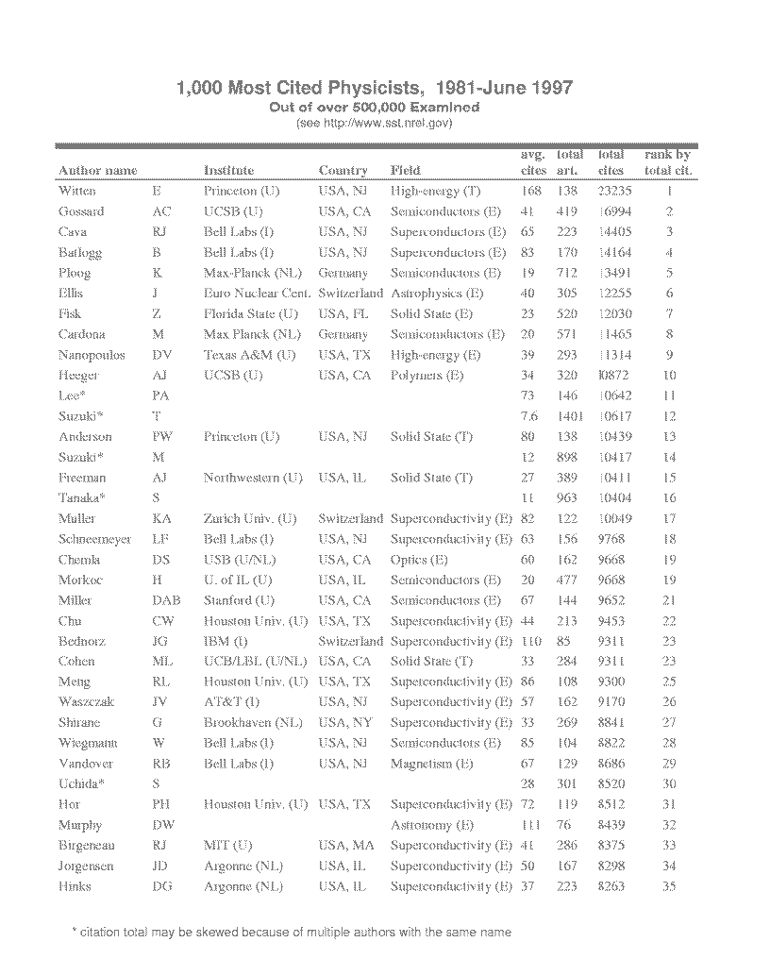
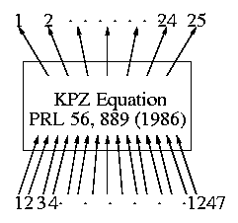
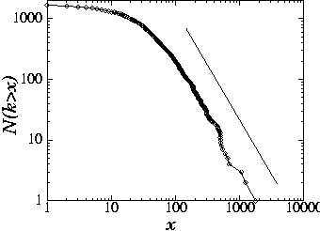
SCIENCE CITATION INDEX
Nodes: papers
Links: citations
25
H.E. Stanley,...
1736 PRL papers (1988)
578...
P(k) ~k^{-γ}
(γ = 3)
(S. Redner, 1998)
Network Science: Scale-Free Property

Slide 28



SCIENCE COAUTHORSHIP
Nodes: scientist (authors)
Links: joint publication
M: math
NS: neuroscience
(Newman, 2000, Barabasi et al 2001)
Network Science: Scale-Free Property

Slide 29


ONLINE COMMUNITIES
Nodes: online user
Links: email contact
Pussokram.com online community;
512 days, 25,000 users.
Kiel University log files
112 days, N=59,912 nodes
Ebel, Mielsch, Bornholdtz, PRE 2002.
Holme, Edling, Liljeros, 2002.

Slide 30


ONLINE COMMUNITIES
Twitter:
Facebook
Jake Hoffman, Yahoo,
Brian Karrer, Lars Backstrom, Cameron Marlowm ²⁰¹¹
Notes:
FACEBOOK: The complementary cumulative distribution function (CCDF). The CCDF at degree k measures the fraction of users who have degree k or greater and in terms of the degree distribution is 􏰂k′ ≥k pk′ . For the U.S., the degree measures the number of friends also from the United States.

Slide 31









Bio-Map
GENOME
protein-gene interactions
PROTEOME
protein-protein interactions
METABOLISM
Bio-chemical reactions
Citrate Cycle

Slide 32
METABOLISM
Bio-chemical reactions
Citrate Cycle

Slide 33


BOEHRING-MENNHEIN

Slide 34


Meta-P(k)
METABOLIC NETWORK
Archaea
Bacteria
Eukaryotes
Organisms from all three domains of life are scale-free!
H. Jeong, B. Tombor, R. Albert, Z.N. Oltvai, and A.L. Barabasi, Nature, 407 651 (2000)
Network Science: Scale-Free Property

Slide 35
Bio-Map
GENOME
protein-gene interactions
PROTEOME
protein-protein interactions
METABOLISM
Bio-chemical reactions
Citrate Cycle

Slide 36
METABOLIC NETWORK
PROTEOME
protein-protein interactions
Network Science: Scale-Free Property

Slide 37



Prot P(k)
TOPOLOGY OF THE PROTEIN NETWORK
Nodes: proteins
Links: physical interactions-binding
H. Jeong, S.P. Mason, A.-L. Barabasi, Z.N. Oltvai, Nature 411, 41-42 (2001)

Slide 38




C. Elegans
Drosophila M.
Li et al. Science 2004
Giot et al. Science 2003

Slide 39


HUMAN INGTERACTION NETWORK
2,800 Y2H interactions
4,100 binary LC interactions
(HPRD, MINT, BIND, DIP, MIPS)
Rual et al. Nature 2005; Stelze et al. Cell 2005
Network Science: Scale-Free Property

Slide 40





ACTOR NETWORK
Nodes: actors
Links: cast jointly
Days of Thunder (1990)
Far and Away (1992)
Eyes Wide Shut (1999)
N = 212,250 actors
〈k〉 = 28.78
P(k) ~k-γ
γ=2.3

Slide 41


Slide 42

Not all networks are scale-free
Networks appearing in material science, like the network describing the bonds between the atoms in crystalline or amorphous materials, where each node has exactly the same degree.
The neural network of the C.elegans worm.
The power grid, consisting of generators and switches connected by transmission lines
Notes:
A carbon atom can share only four electrons with other atoms, hence no matter how we arrange these atoms relative to each other, in the resulting network a node can never have more than four links. Hence, hubs are forbidden and the scale-free property cannot emerge. The figure shows several carbon allotropes, each characterized by a different “network”, resulting in materials with different physical characteristics, like (a) diamond; (b) graphite; (c) lonsdaleite; (d) C60 (buckminsterfullerene); (e) C540 (a fullerene) (f) C70 (another fullerene); (g) amorphous carbon; (h) single-walled carbon nanotube. After http://www.thenanoage.com/Figures/Eight_Allotropes_of_Carbon.png
The ubiquity of the scale-free property does not mean that all real networks are scale-free. Indeed, several important networks do not share this property:Networks appearing in material science, like the network describing the bonds between the atoms in crystalline or amorphous materials, where each node has exactly the same degree.The neural network of the C.elegans worm. The power grid, consisting of generators and switches connected by transmission lines.For the scale-free property to emerge the nodes need to have the capacity to link to an arbitrary number of other nodes. These links do not need to be simultaneous: we do not constantly chat with each of our acquaintances and a protein in the cell does not simultaneously bind to each of its potential interaction partners. In general the scale-free property is absent in systems that have a limitation in the number of links a node can have, as such limitations limit the size of the hubs. As illustrated in the image, such limitations are common in materials, explaining why they cannot develop a scale-free topology.

Slide 43
Section 6
Ultra-small property

Slide 44





DISTANCES IN RANDOM GRAPHS
Random graphs tend to have a tree-like topology with almost constant node degrees.
no. of first neighbors:
no. of second neighbors:
no. of neighbours at distance d:
estimate maximum distance:
Network Science: Scale-Free Property

Slide 45



Distances in scale-free networks
SMALL WORLD BEHAVIOR IN SCALE-FREE NETWORKS
Size of the biggest hub is of order O(N). Most nodes can be connected within two layers of it, thus the average path length will be independent of the system size.
The average path length increases slower than logarithmically. In a random network all nodes have comparable degree, thus most paths will have comparable length. In a scale-free network the vast majority of the path go through the few high degree hubs, reducing the distances between nodes.
Some key models produce γ=3, so the result is of particular importance for them. This was first derived by Bollobas and collaborators for the network diameter in the context of a dynamical model, but it holds for the average path length as well.
The second moment of the distribution is finite, thus in many ways the network behaves as a random network. Hence the average path length follows the result that we derived for the random network model earlier.
Small World
Cohen, Havlin Phys. Rev. Lett. 90, 58701(2003); Cohen, Havlin and ben-Avraham, in Handbook of Graphs and Networks, Eds. Bornholdt and Shuster (Willy-VCH, NY, 2002) Chap. 4; Confirmed also by: Dorogovtsev et al (2002), Chung and Lu (2002); (Bollobas, Riordan, 2002; Bollobas, 1985; Newman, 2001

Slide 46

Why are small worlds surprising? Suprising compared to what?
Network Science: Random Graphs January 31, 2011
Notes:
Much of our intuition about distance is based on our experience with the phys- ical space, or distances in regular lattices. These do not display the small world phenomenon. Indeed, for a one-dimensional lattice (a line of length N) the network diameter and the average path length scale linearly with N: dmax ∼ ⟨d⟩ ∼ N. For a square lattice dmax ∼ ⟨d⟩ ∼ N1/2 and for a cubic lattice dmax ∼ ⟨d⟩ ∼ N1/3. In general, for a d-dimensional lattice we have dmax ∼ ⟨d⟩ ∼ N1/d. This polynomial form predicts a much faster increase than the logarithmic form Eq. (23) for a random network, indicating that in regular lattices the path lengths are significantly longer than in a random net- work. This difference is illustrated in the figure above that shows the predicted N-dependence of ⟨d⟩ (or dmax), for various regular and random networks. The right panel shows the same dependence on a log-log scale. For example, if the social network would form a regular 2d lattice, where each individual knows only those in its immediate physical vicinity, the typical distance between two randomly chosen individuals would be roughly (7 × 107)1/2 = 83, 666. Even if we correct for the fact that a person has about 1,000 acquaintances, not four, the average separation will be orders of magnitude larger than predicted by Eq. (22). Many laws of nature rely on precise distance measures: Newton’s law of gravi- tation is expressed in terms of the distance between two planets; the likelihood of two individuals to know each other decreases rapidly with the physical dis- tance between them. In networks the path length plays the role of the physical distance. Yet, as the path length depends on logN, many systems can have comparable diameter, making it difficult to distinguish them based on their average or maximum path length.

Slide 47


Distances in scale-free networks
SMALL WORLD BEHAVIOR IN SCALE-FREE NETWORKS

Slide 48

We are always close to the hubs
" it's always easier to find someone who knows a famous or popular figure than some run-the-mill, insignificant person.”
(Frigyes Karinthy, 1929)

Slide 49
Section 7
The role of the degree exponent

Slide 50

SUMMARY OF THE BEHAVIOR OF SCALE-FREE NETWORKS

Slide 51


Distances in scale-free networks
Graphicality: No large networks for γ<2
In scale-free networks:
For γ<2: 1/(γ-2)>1
Notes:
textbf{Box 4: Graphicality and the impossibility of networks with $\gamma < 2$.}
To see why we lack networks with $\gamma < 2$, we need to attempt to build a scale-free network with $\gamma < 2$. For this we first generate a degree sequence by generating $N$ numbers from a $p_k$ distribution with the selected $\gamma$. That is, we pick $N$ random numbers, $k_1, k_2, \dots, k_N$, from the $p_k$, corresponding to the degree of the nodes in the network, as shown in (a). Next we connect the stubs to each other, obtaining the network.
Yet, not all degree sequences can be turned into a network. For example, if the number of stubs is odd, there will be always one stub unmatched, as shown in (b). The degree sequences that can be turned into simple graphs are called {graphical} \cite{Erdos_Matematikai-Lapok_1960}.
Graphicality can be tested with an algorithm proposed by Erd\H{o}s and Gallai \cite{Erdos_Matematikai-Lapok_1960, Del-Genio_PLoS-ONE_2010} based on a theorem by Havel and Hakimi \cite{Havel_Casopis-Pest-Mat_1955, Hakimi_SIAM-J-Appl-Math_1962}. The algorithms indicate that all networks with $\gamma > 2$ are graphical, that is, any degree sequence generated with $\gamma >2$ can be turned into a scale-free network. The number of graphical degree sequences drops to zero for $\gamma<2$ (see Figure \ref{F-SF-Graphicality}b), meaning that in this regime the degree sequences simply can not be turned into networks.
The reason for the lack of graphicality can be found in Eq. (\ref{K_max_Sim_K_min}). For $\gamma<2$ the exponent $\frac{1}{(\gamma-1)}$ is larger than one, hence for networks in this regime the largest hub grows faster than the network size $N$. In a simple graph a node can have at most one link to any other node, hence the degree of the largest hub cannot exceed $N-1$. According to (\ref{K_max_Sim_K_min}), for sufficiently large $N$, the largest hub is supposed to have more links than $N-1$, hence it will not find enough nodes to link to, leading to the breakdown of graphicality.

Slide 52




Why don’t we see networks with exponents in the range of γ=4,5,6, etc?
In order to document a scale-free networks, we need 2-3 orders of magnitude scaling. That is, K_{max}~ 10³
However, that constrains on the system size we require to document it.
For example, to measure an exponent γ=5,we need to maximum degree a system size of the order of
Mobile Call Network
N=4.6x10⁶
γ=8.4
Onella et al. PNAS 2007
Network Science: Scale-Free Property

Slide 53
ADVANCED TOPICS 4.B
PLOTTING POWER LAWS

Slide 54

HUMAN INTERACTION NETWORK
2,800 Y2H interactions
4,100 binary LC interactions
(HPRD, MINT, BIND, DIP, MIPS)
Rual et al. Nature 2005; Stelze et al. Cell 2005
Network Science: Scale-Free Property

Slide 55





(linear scale)
Network Science: Scale-Free Property

Slide 56

HUMAN INTERACTION DATA BY RUAL ET AL.
P(k) ~ (k+k₀)^{-γ} k₀ = 1.4, γ=2.6.
(linear scale)
Network Science: Scale-Free Property

Slide 57


Http://www.nd.edu/~networks
COMMON MISCONCEPTIONS
Network Science: Scale-Free Property

Slide 58
Section 8
Generating networks with a pre-defined p_{k}

Slide 59


Configuration model
(1) Degree sequence: Assign a degree to each node, represented as stubs or half-links. The degree sequence is either generated analytically from a preselected distribution (Box 4.5), or it is extracted from the adjacency matrix of a real network. We must start from an even number of stubs, otherwise we will be left with unpaired stubs. (2) Network assembly: Randomly select a stub pair and connect them. Then randomly choose another pair from the remaining stubs and connect them. This procedure is repeated until all stubs are paired up. Depending on the order in which the stubs were chosen, we obtain different networks. Some networks include cycles (2a), others self-edges (2b) or multi-edges (2c). Yet, the expected number of self- and multi-edges goes to zero in the limit.

Slide 60

Degree Preserving randomization

Slide 61







Hidden parameter model

Slide 62

Hidden parameter model
Start with N isolated nodes and assign to each node a “hidden parameter” η , which can be randomly selected from a ρ(η) distribution. We next connect each node pair with probability
For example, the figure shows the probability to connect nodes (1,3) and (3,4). After connecting the nodes, we end up with
the networks shown in (b) or (c), representing two independent realizations generated by the same hidden parameter sequence (a). The expected number of links in the obtained network is

Slide 63

Decision tree

Slide 64


Case Study: PPI Network

Slide 65
Section 9
summary

Slide 66



Section 9

